Slide 1

Online Hotel Management System
Developed By,
Chate Adarsh Vikas

Slide 2

Pune District Education Association’s Annasaheb Magar Mahavidyalaya, Hadapsar Pune Hadapsar, Pune - 411 028.
A
PROJECT REPORT
ON
“HOTEL MANAGEMENT SYSTEM”
BACHELOR OF BUSINESS ADMINISTRATION (COMPUTER APPLICATION)
Sem-V 2021-2022.
SUBMITTED TO
Savitribai Phule Pune University
DEVELOPED BY:
Chate Adarsh Vikas,
UNDER THE GUIDANCE OF
Prof. Asha Mane.
Annasaheb Magar Mahavidyalaya
Hadapsar, Pune - 411028.

Slide 3
Index
Chapter No. | Particular Name | Page No.
1 | INTRODUCTION 1.1 Organization Profile 1.2 Introduction of System 1.3 Problem Statement 1.4 Proposed of System 1.5 Scope and Limitation of Existing System | 6 7 8 9 10
2 | SYSTEM ANALYSIS 2.1 Existing System 2.2 Project Perspective 2.3 Requirement Analysis 2.4 Feasibility Study 2.5 Fact Finding Technique 2.6 Implementation Details | 12 13 14 15-16 17 18-19
3 | SYSTEM DESIGN 3.1 Design Constraint 3.2 Entity Relationship Diagram [ERD] 3.3 Data Flow Diagram [DFD] 3.4 Data Dictionary 3.5 File Design | 21 22 23-25 26-29 30-36
4 | INPUT/OUTPUT AND REPORT | 38-45

Slide 4
Index
Chapter No. | Particular Name | Page No.
5 | TESTING 5.1 Test plan 5.2 Black Box Testing 5.3 White Box Testing 5.4 Validation Test Cases and Result | 47 48 49 50
6 | ADVANTAGES AND LIMITATIONS | 52
7 | CONCLUSION | 54
8 | FUTURE ENHANCEMENT | 56
9 | BIBLIOGRAPHY AND REFERENCES | 58

Slide 5


1. Introduction

Slide 6
1 Organization Profile
Organization Name :- Balaji Hotel.
Organization Address :- 52, Pune - Solapur Rd, Near Indraprastha
Society, Hadapsar,Pune, Maharashtra 411028.
Manager Name :- Pramod Sawant.
Mobile Number :- 709-705-7777.
Established In :- 2021.
Email :- balajihotel7@gmail.com
Working Profile :- Hotel Management System Provides various facilities to maintain the user, Reservations of Rooms, Customer Records, Payments, Bill reports, and others related to hotel.

Slide 7
1.2 Introduction to System
Project Name:- Hotel Management System.
Name Of Organization:- Balaji Hotel.
Project Descriptions :-
The Project of “Hotel Management System” on basis of the providing Hotel services including all the Services given by the Hotels Agency.
The Project of “Hotel Management System” on basis of the providing Hotel services facilities for booking hotels, Events, holiday apartments including all the Services given by the Hotels and other accommodations for customers. Balaji Hotels manager They operate their business in Pune . Any customers need to book hotel, or apartment they need to visit their office which for checking the availability as well as negotiation. Recently they have decided to change their booking pattern from manual to web based system. It will help them to manage the customers booking easily and also to keep the customers data safer. It will also help staffs to keep in track their customer’s online booking request as well as easily to reply feedback to the customer.

Slide 8
1.3 Problem Statement
As Hotels Booking Is Having Manual Booking System, They Are Facing Some Problems Issuing Booking Requests of Customers. All The Necessary Booking Stuffs Are Being Done in Hard Copy. So, It Become Much Difficult for Staffs to Keep the Records Updated All the Time.
As For Example, If the Customers Need to Change the Check in Date It Become Difficult for Them to Find Out the Customers Booking Details for Updating as There Are So Many Customers Booking Records. Again, Regarding Current System Customers Cannot Give Feedback Online and Also Staff Cannot Reply to Them Promptly.
Besides Tourists from Other location Need to Call Directly for Booking Purposes. So, They Cannot Get the Chance to View Their Apartment Rooms or Hotels Rooms Before They Make Book.

Slide 9
1.4 Proposed System
The purpose of this project is to create a functional website for users to reserve the hotel room across the world. Users of this website will be able use an easy-to-use interface in order to search, sort, reserve room and services across the world. Create an account option will secure their data and allow easy access to various services and facilities.
One of the main purposes of this project is to allow customer to have online booking of room and other services with registered business partner.It is difficult to maintain bulk of record in manual.
The basic requirements state that the users will be able to search for room based on and able to make instant online payment. They will also be able to navigate through available other options by category, or by using a well-executed search function. The website will be maintained and managed by administrator. They will have the authority to manage the products and offers.
Efficient data management and reusability.
Highly accessible for users.
Enable easy authorized modification of data
To enable automated data entry methods.
Security of User information and other can maintain.
On a figure tip, we can access any information with proper authority.
The proposed system will available and function 24*7 and accessible
for worldwide. Thus, the customers can use the system very easily.

Slide 10
1.5 Scope and Limitation Of existing System
Scope of existing System :
System management manually .
Human interaction is required to create booking.
Not needed electricity and any electronic devices.
Store data in using paper format.
Borrowed items can be written off.
Limitation:
Increases the paper work.
Time Consuming.
Non-secure.
No method to trace details.
Human errors.

Slide 11
2. SYSTEM ANALYSIS

Slide 12
2.1 Existing System
Study Of Existing System
The current manual reservation system uses paper and direct human interaction to book the hotel room and manage reservations. This makes delays exchanging of information in the hotel.
The existing system is a manual one and there is lot of issues like erroneous data, slow process, lack of security etc. Finding out the final payment amount completely relies on the hotel manager and if he is absent, it takes a long time to find out the details during check out and is prone to errors.
Advantages Of the Existing System
Employee with the no computer skill or any special skill is required.
No need to rely on any device to access or use data.
Human interaction is required to create booking.
Disadvantages Of the Existing System
It is difficult to maintain bulk of record in manual.
Lot of paperwork.
Non-secure.
No method to trace details.
Human errors.
The manual system is too slow.
Searching is more time consuming.

Slide 13
2.2 Project Perspective
In this system make easier and more attractive.
This system will be fully online in the future.
In the System, payment options and all other futures
will be added to this system.
In this system , we will make sure that records are
auto-saved and records will not be corrupt.

Slide 14
2.3 Requirement Analysis
Requirement’s analysis is the analysis definition process of requirements, is the start of the planning and development period of the project. Needs analysis task is to thoroughly describe the function and performance of the software, identify limits of software design and software interface details with other elements of the system, defining the effectiveness of software requirements. Requirement’s analysis includes business requirements, functional requirements and development requirements.

Slide 15
2.4 Feasibility Study
The feasibility study helps to know whether the system implemented is economically viable and beneficial to organization. A feasibility study conducted once the problem is clearly understood is a high-level capsule version of the complete system analysis and design process The purpose is to determine at the minimum expense and how quickly resolve the problem and to determine what her problem is solved the following feasibility in the following ways There are three types of feasibility study.
1.technical feasibility
2. operational feasibility
3. Economical feasibility.
Technical Feasibility:
The technical feasibility of work performance can affect study and ability to achieve limitations.
Acceptable Systems Software developed to manage hotel reservation systems is used in client servers.
The project is technically feasible as a front end with architecture html, css, JavaScript, php and SQL Server back end.

Slide 16
Operational Feasibility:
The main objective of the program is to develop a web-based application that facilitates online reservations.
This is because all the users in his project of hotel accommodation arrangement through internet are trained in this field The project can be executed.
The proposed system offers greater level of user friendliness.
The proposed system produces best results and gives high performance. It can be implemented easily. So, this project is operationally feasible.
Economical Feasibility:
Economic feasibility analysis includes a broad range of tests that include long-term cooperative income strategies, cost of resources needed for development, cost-benefit analysis.
In the existing system, they had to maintain many registers/books is a costly affair. This can be reduced by keeping data in a digital format that is reliable and cheaper. Since the development cost for the system satisfies the organization therefore the software is economically feasible.
The costs conduct a full system investigation.
The cost of the hardware and software.
The benefits in the form of reduced costs or fewer costly errors. Since the system is developed as part of project work, there is no manual cost to spend for the proposed system.

Slide 17
2.5 Fact Finding Techniques
Various Fact-Finding Techniques Were Used to Collect Detailed Information About Each and Every Aspect of the “Hotel Management System”. In Order to Gather and Analysis the Relevant Information the Following Fact-Finding Techniques Were Adopted.
Observation
The Hotel manager was interviewed to know how the hotel handles any issue or complains from the any guest and then discussed how the proposed system will convenient for customers to make reservation/booking at any time. From the interview the hotel manager was able to provide few requirements needed for the website and a survey was carried out in the hotel with few guests who were willing to fill the questionnaires.
STUDY OF DOCUMENTS (Record Review):
Various documents involved in the process of new client & different types of customers and discount facility and billing system were studied. Such documents were useful in designing various input documents in the proposed system.
INTERVIEW:
Timely discussions with concerned persons i.e., Balaji Hotels Manager, Staff of the Balaji Hotels to understand the exact requirement of the system. The discussions were also useful in bringing new ideas in making the system more effective.

Slide 18
2.6 Implementation Details
Hardware Specifications
For the Development System following Hardware and Software are Required.
Hardware Requirements (minimum ):
Desktop PC or a Laptop.
Printer.
Hardware Requirements Processor: Intel i3 or Higher.
Disk space: 120 GB or Higher.
RAM : 4 GB or Higher.
Ethernet card with an Internet and Internet zone/ Connection.
For Server-Side Requirements. ( Hosting - after completing development)
Hardware Requirements :
20 GB Cloud Storage (HDD/SSD)
4 Gb or more RAM

Slide 19


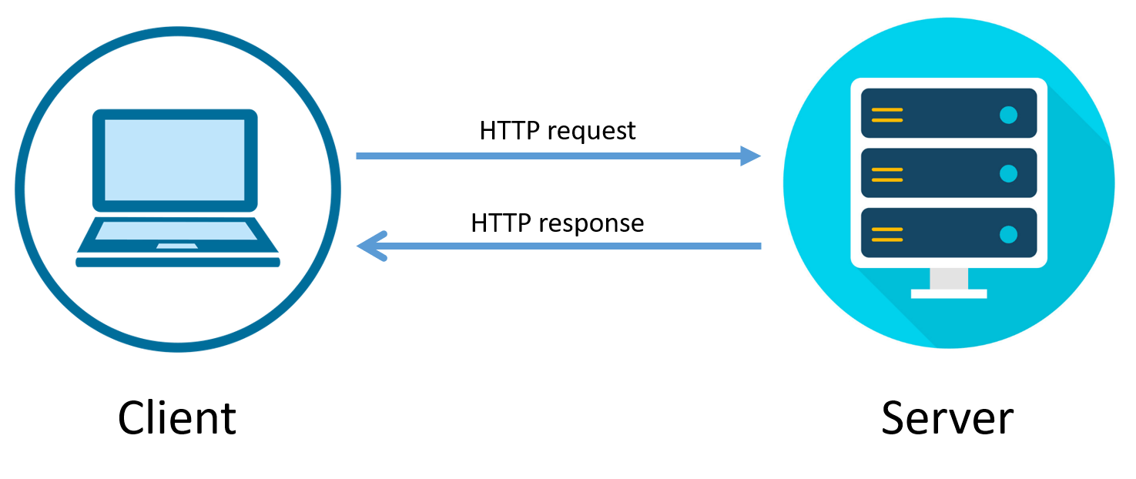
Software Specifications
For the Development System following Hardware and Software are Required.
Software Requirements
Windows 7 or Windows or higher versions of OS.
Any Latest Web Browser. (Preferably, Mozilla Firefox, Google chrome)
Visual Studio as an IDE. or any other IDE.
XAMPP Server or any other local server.
Front End: HTML, CSS, JavaScript.
Back End: Php, MySQL.
For Server-Side Requirements. ( Hosting - after completing development)
Software Requirements :
cPanel
MySQL (5.5 or higher)
PHP (7.2 or higher)
Client-Side Requirements For accessing the System :
Client-Side can have any One Device - Smartphone, Tablet , Computer etc.
Client-Side Requirements should be a good internet connection.
Platform for use: Open any One new updated Web Browsers like Google Chrome, Firefox, Safari etc.

Slide 20

3. SYSTEM DESIGN

Slide 21
3.1 Design Constraint
This “Hotel MANAGEMENT SYSTEM” running in Any device browsers environment. The Hotel management system developed in PHP language Using database in MySQL .
To developed this system also use these languages - we use the html, css, JavaScript.

Slide 22
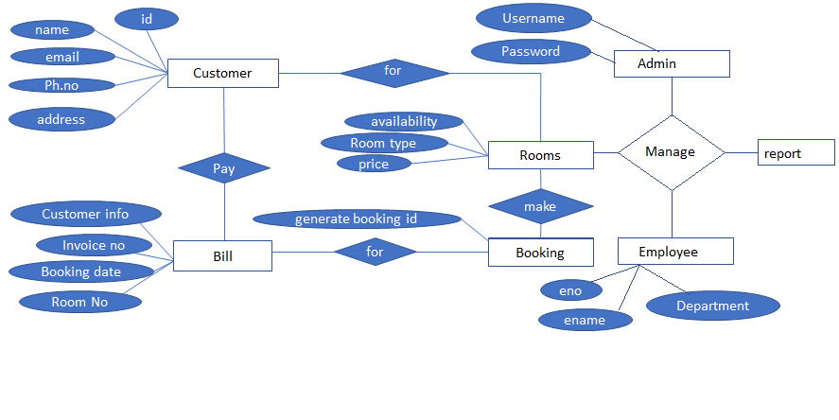
3.2 Entity Relationship Diagram [ERD]

Slide 23
3.3 Data Flow Diagram [DFD]
Level: 0
Admin
Room
Username
Rooms Type Rate
customer
Customer details add
Hotel Management System
Login Successful
Admin
Booking details
Information Customer
Booking
customer
Booking
Details
Employee details
Booking
Employee
Manage Employee
Employee
Bill Details
Data Manage
Bill
Management

Slide 24
1.0
Login
Admin
Admin
admin login
Admin
2.0
Customers
Records
Customer
customer
customer information
Customer
3.0
Room
details
Room
Select Room
Rooms
Room
4.0
Booking
Info.
Booking
Calculation’s,
Generate
inv.no
Generate booking
Booking

Slide 25
5.0
Bill Generate
Bill
Pay Customer
Bill, bookings info.
Bill
6.0
Employee
Management
Employee
Employee info.
Employee info.
Employee
6.0
Employee
Management
Employee info.
Employee info.
Employee
Employee
Admin
Admin login
Customer
Customer Info.
7.0
Report Generation
Customer data
Room details
Room manage
Management
Room
Booking’s ,billings info.
Booking details
Employee Info.
Booking
Billing info.
All Bookings Info. and payment info
Bill
Employee Details
Employee

Slide 26
3.4 Data Dictionary
Database Name | Table Name | Field Name | Field Type, Size | Key Type
balajihotel | id_card_type | icard_id | int(3) | Primary Key
 |  | icard_type | varchar(30)
balajihotel | Customer | cid | int(5) | Primary Key
 |  | fname | varchar(15)
 |  | lname | varchar(15)
 |  | ph_no | bigint(13)
 |  | email | varchar(30)
 |  | icard_id | int(3) | Foreign Key
 |  | id_number | varchar(20)
 |  | createdate | varchar(22)
 |  | invnum | varchar(10)
 |  | address | varchar(40)
balajihotel | room_type | rty_id | int(3) | Primary Key
 |  | roomty | varchar(25)
 |  | price | int(8)
 |  | rtstatus | int(3)
balajihotel | rooms | rid | int(3)
 |  | rno | varchar(5) | Primary Key
 |  | rty_id | int(2) | Foreign Key
 |  | status | int(3)
 |  | chkin | int(3)
 |  | chkout | int(3)
 |  | rdelete | int(3)

Slide 27
Database Name | Table Name | Field Name | Field Type, Size | Key Type
balajihotel | bookings | bid | int(5) | Primary Key
 |  | cid | int(5) | Foreign Key
 |  | rno | varchar(5) | Foreign Key
 |  | rty_id | int(3) | Foreign Key
 |  | bdate | varchar(22)
 |  | ckindate | varchar(15)
 |  | ckoutdate | varchar(15)
 |  | pkprice | int(6)
 |  | nofday | int(3)
 |  | tprice | int(6)
 |  | remprice | varchar(6)
 |  | paystatus | varchar(6)
 |  | invno | varchar(10)
 |  | bkstatus | int(3)
balajihotel | log | lid | int(3) | Primary Key
 |  | usname | varchar(15)
 |  | pass | varchar(15)
balajihotel | cancelbookings | ccid | int(5) | Primary Key
 |  | cid | int(5) | Foreign Key
 |  | name | varchar(15)
 |  | rno | varchar(5) | Foreign Key
 |  | ckindate | varchar(15)
 |  | ckoutdate | varchar(15)
 |  | pkprice | int(6)
 |  | nofday | int(3)
 |  | tprice | int(6)
 |  | invno | varchar(10)
 |  | canceldt | varchar(22)
 |  | cancelreas | varchar(40)
 |  | bnkname | varchar(30)
 |  | accno | varchar(30)

Slide 28
Database Name | Table Name | Field Name | Field Type, Size | Key Type
 |  | ifscc | varchar(20)
 |  | upiid | varchar(40)
 |  | cancelpaystatus | varchar(6)
balajihotel | cancelpayment | cpid | int(5) | Primary Key
 |  | ccid | int(5) | Foreign Key
 |  | transactionid | varchar(40)
 |  | pamount | varchar(9)
 |  | reduceper | varchar(5)
 |  | paidamount | varchar(9)
 |  | paiddate | varchar(25)
 |  | profit_amt | varchar(10)
balajihotel | mesg | srno | int(11) | Primary Key
 |  | fname | varchar(12)
 |  | lname | varchar(12)
 |  | contactus | varchar(13)
 |  | subdate | varchar(20)
 |  | messub | text
balajihotel | empdgon | edid | int(3) | Primary Key
 |  | edname | varchar(25)
 |  | esalary | varchar(9)
 |  | edstatus | int(3)
balajihotel | empattend | aeid | int(5) | Primary Key
 |  | eid | int(5) | Foreign Key
 |  | achkdate | varchar(25)
 |  | eastatus | int(3)
 |  | eapaystatus | int(3)
balajihotel | empdetail | eid | int(5) | Primary Key
 |  | efname | varchar(15)
 |  | elname | varchar(15)

Slide 29
Database Name | Table Name | Field Name | Field Type, Size | Key Type
 |  | eph_no | bigint(13)
 |  | eemail | varchar(30)
 |  | icard_id | int(3) | Foreign Key
 |  | eid_number | varchar(20)
 |  | createdate | varchar(22)
 |  | edname | varchar(25) | Foreign Key
 |  | eaddress | varchar(40)
 |  | estatus | int(3)

Slide 30
3.5 File Design
identity type:
Field | Type | Null | Key | Default | Extra
icard_id | int(3) | NO | PRI | NULL
icard_type | varchar(30) | NO |  | NULL
Customer :
Field | Type | Null | Key | Default | Extra
cid | int(5) | NO | PRI | NULL | auto_increment
fname | varchar(15) | YES |  | NULL
lname | varchar(15) | YES |  | NULL
ph_no | bigint(13) | YES |  | NULL
email | varchar(30) | YES |  | NULL
icard_id | int(3) | YES |  | NULL
id_number | varchar(20) | YES |  | NULL
createdate | varchar(22) | YES |  | NULL
invnum | varchar(10) | YES |  | NULL
address | varchar(40) | YES |  | NULL

Slide 31
Room Type
Field | Type | Null | Key | Default | Extra
rty_id | int(3) | NO | PRI | NULL
roomty | varchar(25) | YES |  | NULL
price | int(8) | YES |  | NULL
rtstatus | int(3) | YES |  | NULL
Field | Type | Null | Key | Default | Extra
rid | int(3) | YES |  | NULL
rno | varchar(5) | NO | PRI | NULL
rty_id | int(2) | YES |  | NULL
status | int(3) | YES |  | NULL
chkin | int(3) | YES |  | NULL
chkout | int(3) | YES |  | NULL
rdelete | int(3) | YES |  | NULL
Rooms

Slide 32
Bookings
Field | Type | Null | Key | Default | Extra
bid | int(5) | NO | PRI | NULL | auto_increment
cid | int(5) | YES |  | NULL
rno | varchar(5) | YES |  | NULL
rty_id | int(3) | YES |  | NULL
bdate | varchar(22) | YES |  | NULL
ckindate | varchar(15) | YES |  | NULL
ckoutdate | varchar(15) | YES |  | NULL
pkprice | int(6) | YES |  | NULL
nofday | int(3) | YES |  | NULL
tprice | int(6) | YES |  | NULL
remprice | varchar(6) | YES |  | NULL
paystatus | varchar(6) | YES |  | NULL
invno | varchar(10) | YES |  | NULL
bkstatus | int(3) | YES |  | NULL
Login
Field | Type | Null | Key | Default | Extra
lid | int(3) | NO | PRI | NULL | auto_increment
usname | varchar(15) | NO |  | NULL
pass | varchar(15) | NO |  | NULL

Slide 33
Cancel bookings
Field | Type | Null | Key | Default | Extra
ccid | int(5) | NO | PRI | NULL | auto_increment
cid | int(5) | YES |  | NULL
name | varchar(15) | YES |  | NULL
rno | varchar(5) | YES |  | NULL
ckindate | varchar(15) | YES |  | NULL
ckoutdate | varchar(15) | YES |  | NULL
pkprice | int(6) | YES |  | NULL
nofday | int(3) | YES |  | NULL
tprice | int(6) | YES |  | NULL
invno | varchar(10) | YES |  | NULL
canceldt | varchar(22) | YES |  | NULL
cancelreas | varchar(40) | YES |  | NULL
bnkname | varchar(30) | YES |  | NULL
accno | varchar(30) | YES |  | NULL
ifscc | varchar(20) | YES |  | NULL
upiid | varchar(40) | YES |  | NULL
cancelpaystatus | varchar(6) | YES |  | NULL

Slide 34
Cancel Payments
Field | Type | Null | Key | Default | Extra
cpid | int(5) | NO | PRI | NULL | auto_increment
ccid | int(5) | YES |  | NULL
transactionid | varchar(40) | YES |  | NULL
pamount | varchar(9) | YES |  | NULL
reduceper | varchar(5) | YES |  | NULL
paidamount | varchar(9) | YES |  | NULL
paiddate | varchar(25) | YES |  | NULL
profit_amt | varchar(10) | YES |  | NULL
Messages
Field | Type | Null | Key | Default | Extra
srno | int(11) | NO | PRI | NULL | auto_increment
fname | varchar(12) | YES |  | NULL
lname | varchar(12) | YES |  | NULL
contactus | varchar(13) | YES |  | NULL
subdate | varchar(20) | YES |  | NULL
messub | text | YES |  | NULL

Slide 35
Employee Desingnation
Field | Type | Null | Key | Default | Extra
edid | int(3) | NO | PRI | NULL
edname | varchar(25) | YES |  | NULL
esalary | varchar(9) | YES |  | NULL
edstatus | int(3) | YES |  | NULL
Employee Attendance
Field | Type | Null | Key | Default | Extra
aeid | int(5) | NO | PRI | NULL | auto_increment
eid | int(5) | YES |  | NULL
achkdate | varchar(25) | YES |  | NULL
eastatus | int(3) | YES |  | NULL
eapaystatus | int(3) | YES |  | NULL

Slide 36
Employee details
Field | Type | Null | Key | Default | Extra
eid | int(5) | NO | PRI | NULL | auto_increment
efname | varchar(15) | YES |  | NULL
elname | varchar(15) | YES |  | NULL
eph_no | bigint(13) | YES |  | NULL
eemail | varchar(30) | YES |  | NULL
icard_id | int(3) | YES |  | NULL
eid_number | varchar(20) | YES |  | NULL
createdate | varchar(22) | YES |  | NULL
edname | varchar(25) | YES |  | NULL
eaddress | varchar(40) | YES |  | NULL
estatus | int(3) | YES |  | NULL

Slide 37


4. Input/Output and Report

Slide 38


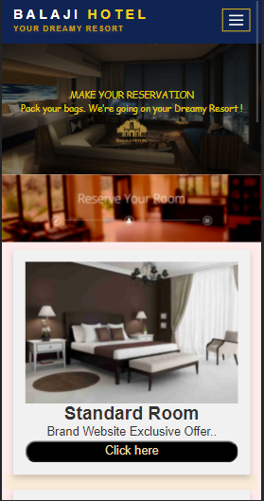
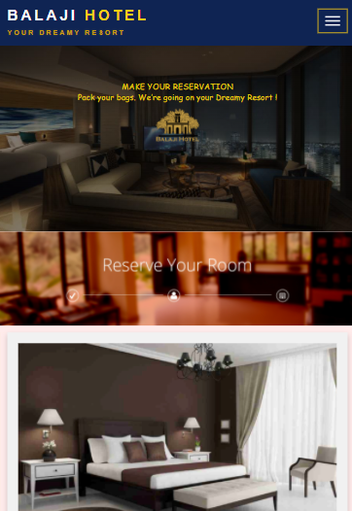

SCREENSHOT

Slide 39

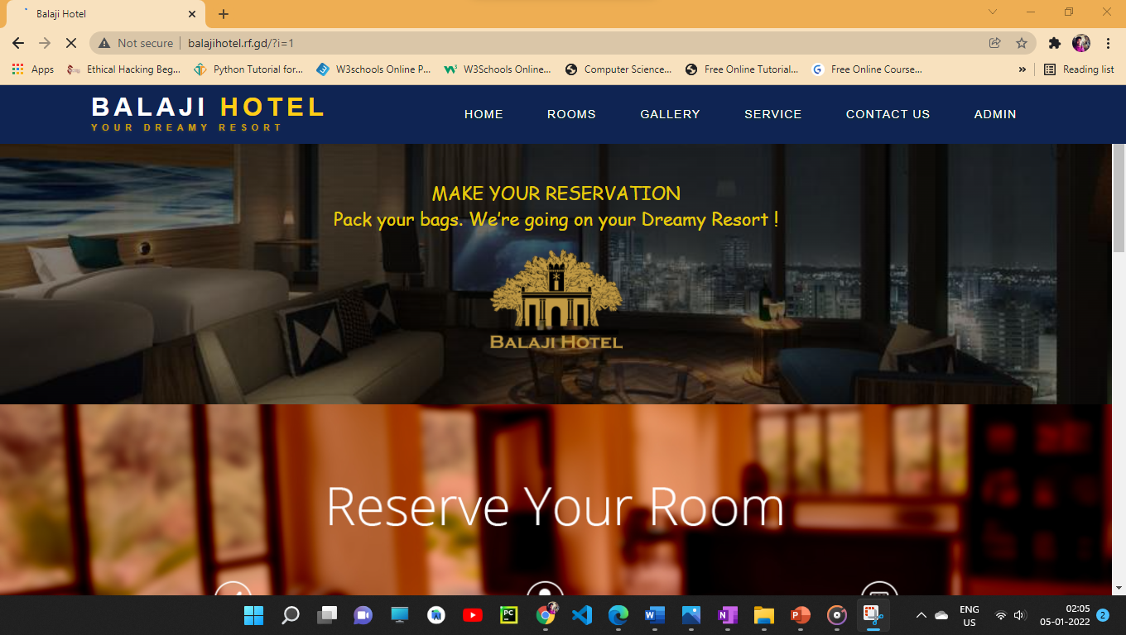
SCREENSHOT

Slide 40

SCREENSHOT

Slide 41
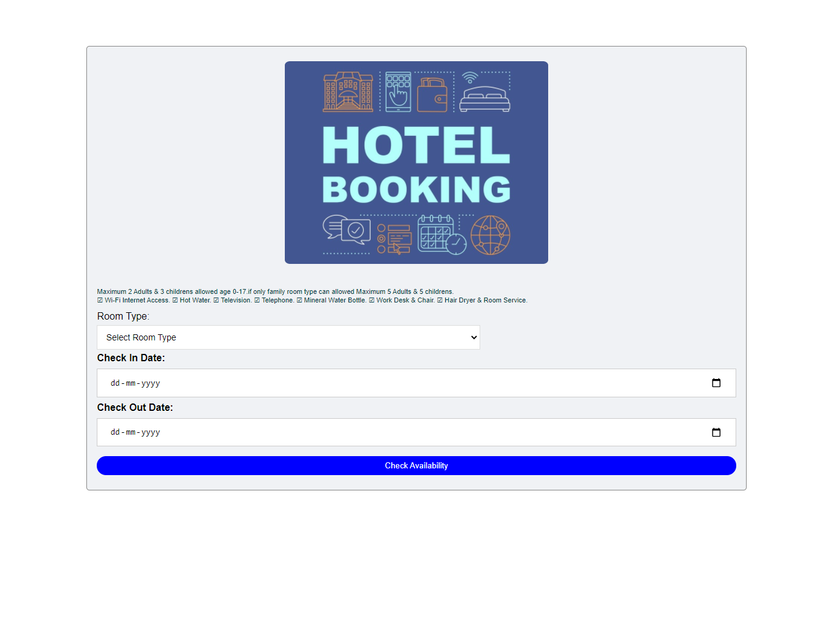
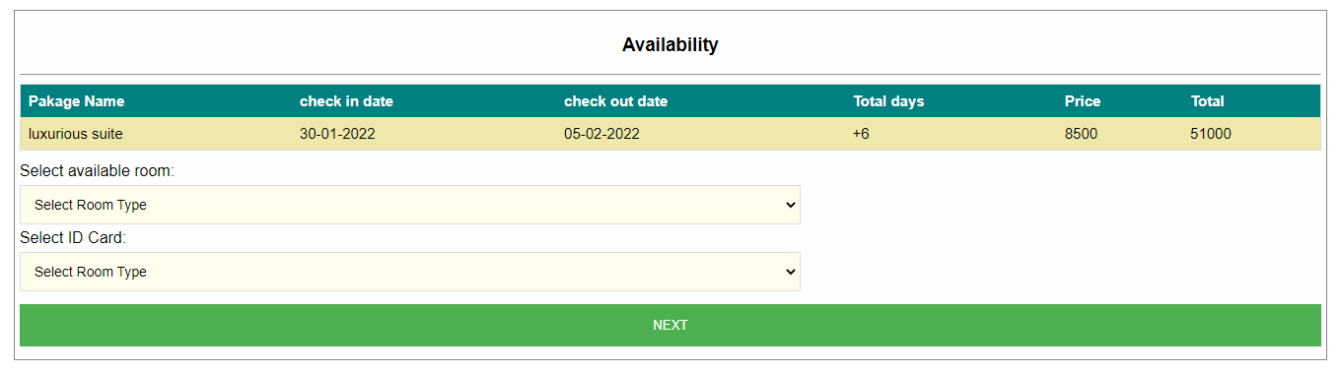
Select Room Type and date
Check Rooms Availability

Slide 42
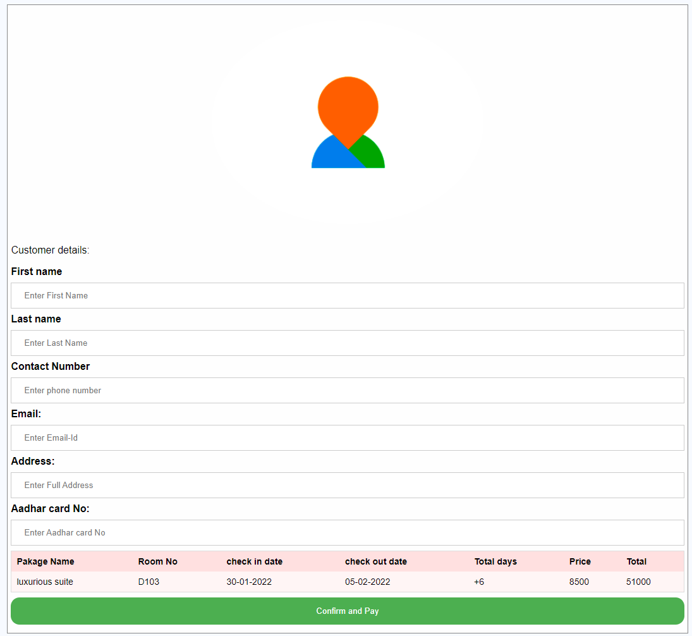
Fill Customer details

Slide 43
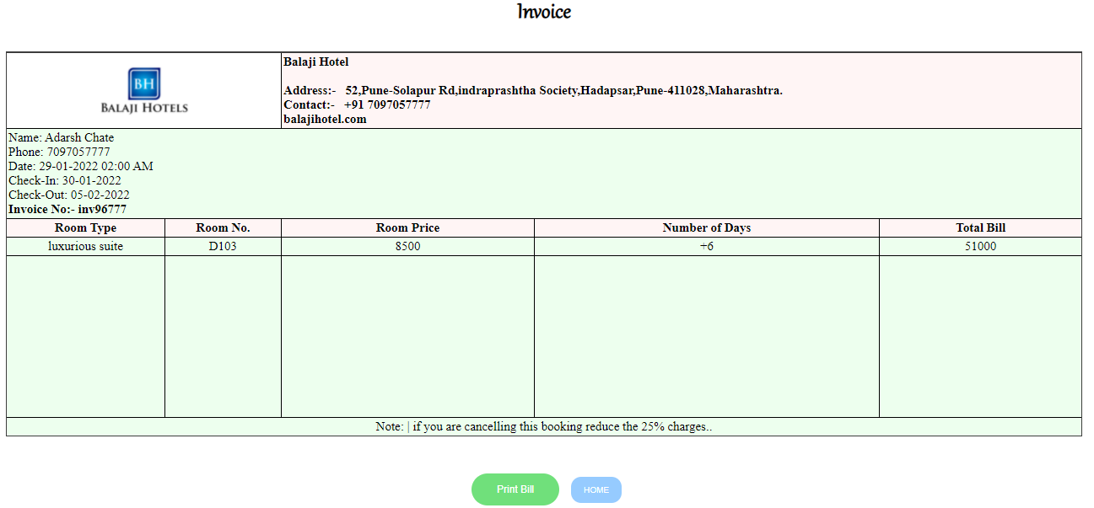
Final Invoice / Bill

Slide 44
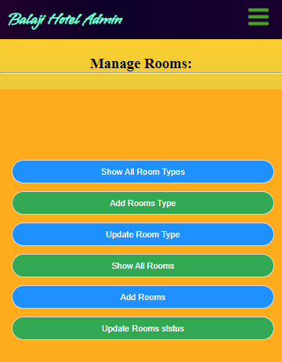
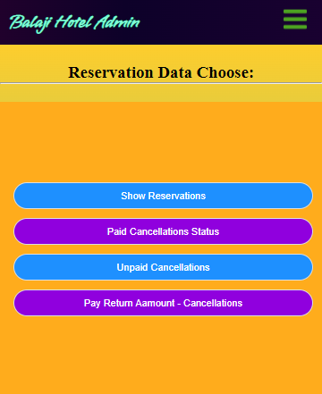
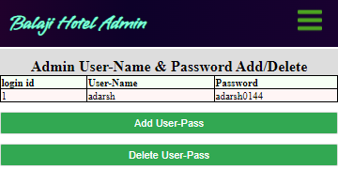
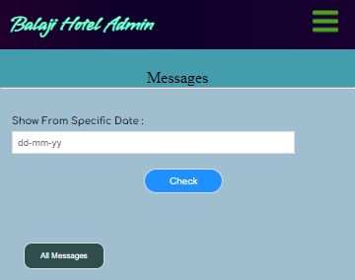
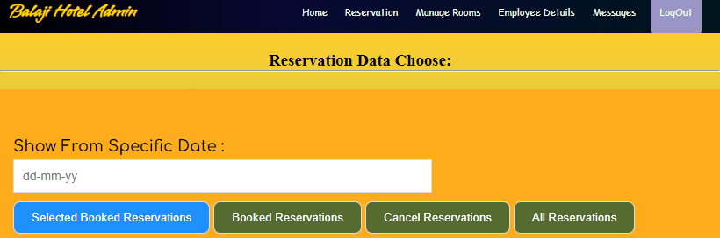
Admin Manage Rooms
Admin Manage Reservation Data
Admin Manage Login
Admin views feedbacks / Massages
Admin View reservation Data

Slide 45
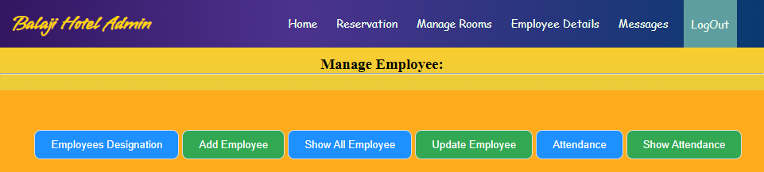
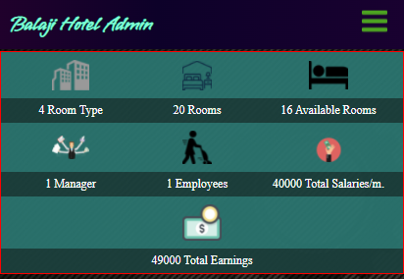
Admin Manage Employee
Admin views Report

Slide 46
5. Testing

Slide 47
5.1 Test Plan
Software testing is critical element of the software quality assurance and represents the ultimate review of specification , design and coding. “Testing is a process of executing a program with the intent of finding error.”
Objectives :
The objective of the system are as follows :
To design different tests that uncovers the error with minimum time and cost.
To check the software function appears to be working according to specifications given by user.
A successful test is one that uncovers with the existing system.
The Software delivered interfaces correctly with the existing system.
Types Of Testing :
Executing the program with the help of test cases and test data generated does testing the testing techniques are used are described as follows:

Slide 48
5.2 Black Box Testing
The end user has concluded Black Box Testing. The user is most concerned with the inputs that the system accepted and the output that if generated.
Using this approach, it is useful in the finding the incorrect or missing function , interface errors , errors in database . initialization and termination errors . The user has checked every GUI form and Reports for error.

Slide 49
5.3 White Box Testing:
White box testing sometimes called as Glass-Box testing . It tests the logic or the code written for the system.
Using this approach , the paths within the module were exercised so that the flow of controls and won’t lead us to make design errors. All the conditions/decision were checked once their true and false side. Loops were tested as their operational boundaries.

Slide 50
5.4 Validation Test Cases and Result
System Testing :
Software and hardware are integrated and fill ranges of the system tests are conducted in an attempt to uncover the error at the software the error at the software interfaces . The backend connectivity (ROLE DB) was checked.
Integration Testing :
Integration testing is also used to test between the different stages of the project . The entire program was tested as a whole.
Load Testing :
The system was tested with load testing . The records were added to the system till it failed . The total numbers of transaction are considered as maximum load for the system speed cube compromised.
Stress Testing :
Stress testing ensures that a system can process its intended workload.
Loading is steadily increased till the system fails.
Modules Testing :
Each module was tested for its functionality . The validations were tested in this approach.

Slide 51
6. Advantages and limitations

Slide 52
ADVANTAGES AND LIMITATIONS
Advantages :
Easy to registration.
Fast System Connectivity
No data duplication.
No Paper Work Required.
Time Efficient.
Cost Efficient.
Automatic data validation.
User friendly environment.
Data security and reliability.
Fast data insertion & retrieval.
Easy performance check.
Limitation :
This system is fully online so a good internet connection is mandatory to both side client-side and also server-side.
Employee or customer with no computer skill or any basic website handling skill is required.

Slide 53
7. Conclusion

Slide 54
CONCLUSION
This project is designed to meet the requirements of Online Hotel Management System. It has been developed in PHP, Servlets keeping in mind the specifications of the system.
The conclusion of this project is A Hotel management system is an Online management system. The proposed system will keep a track of Workers, Residents, Accounts and generation of report regarding the present status. This project has GUI based Web Application that will help in storing, updating and retrieving the information through various user-friendly menu-driven modules.

Slide 55
8. Future Enhancement

Slide 56
FUTURE ENHANCEMENT
Scope of Improvement
Nowadays hotel is providing many other facilities, this project can also be improved with the improvement in the Hotels. The utmost care and backup procedures must be established to ensure 100% successful implementation of the computerized Web-based booking system.
In the future, we may offer web services to large companies such as service providers e.g., makemytrip, trivago, goibibo . This will make it easier for the customer to book or find a hotel, and the business will improve even more.

Slide 57
9. BIBLIOGRAPHY AND REFERENCES

Slide 58
BIBLIOGRAPHY AND REFERENCES
BOOK REFERRED:
Murach’s PHP and MySQL (2nd Edition)by Joel Murach and Ray Harris
SITE REFERRED:
www.tutorialspoint.com/php/
www.javatpoint.com/php-tutorial

Slide 59

Thank You

